Slide 1
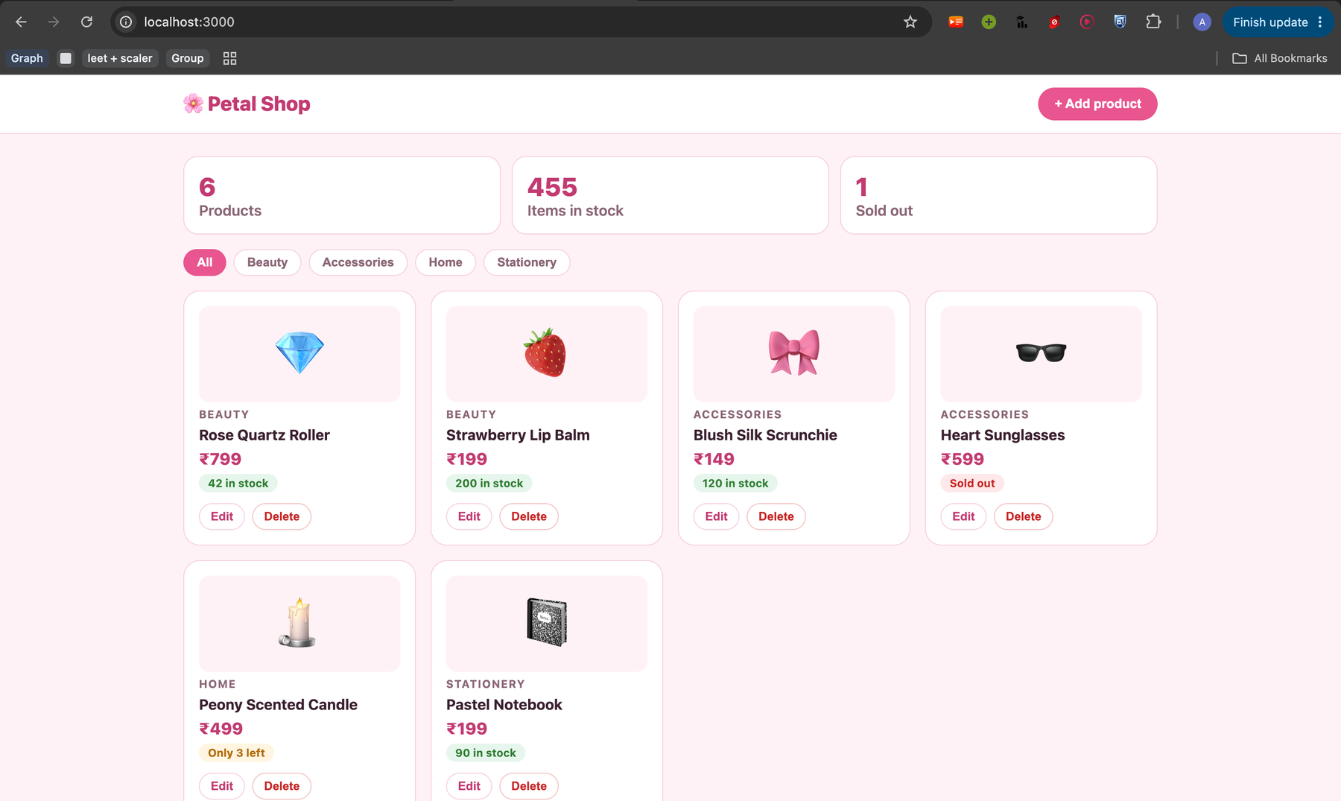
Petal Shop
DevOps & Cloud [SWE] Final Project
github.com/anishkanase-scaler/Devops-Capstone
Notes:
Hi, this is Petal Shop, my final DevOps project. The app is a small online shop. What I want to show is how it is tested, packaged, secured, deployed to Kubernetes and AWS, and monitored.

Slide 2
What I built
A small online shop where you can see, add, edit and delete products.
I kept the app simple so the project could focus on the DevOps work around it.
Notes:
Petal Shop is a small online shop. You can see products, filter them by category, and add, edit or delete them. I kept the app simple so the focus stays on the DevOps part.

Slide 3
How it's built
Frontend
Backend
Database
What the user sees
Handles the requests
Stores the products
React, served by Nginx
Python + FastAPI
PostgreSQL
Each part runs in its own Docker container.
Notes:
The app has three parts. The frontend is what the user sees, built with React and served by Nginx. The backend handles the requests, written in Python with FastAPI. The database stores the products, in PostgreSQL. Each part runs in its own Docker container.

Slide 4
From code to a running app
1
Test
23 automatic tests
Steps 1-4 run automatically on every push (GitHub Actions).
2
Package
Docker images for frontend and backend
3
Scan
Trivy checks the images for security issues
4
Publish
Images saved in GitHub's container registry
5
Cloud
AWS network and cluster created with Terraform
6
Deploy
App installed on Kubernetes with Helm
7
Watch
Prometheus and Grafana show live numbers
Notes:
These are the steps. The first four run automatically on every push to GitHub, using GitHub Actions. The last three I ran myself: AWS with Terraform, Kubernetes with Helm, and monitoring with Prometheus and Grafana. The next slides show each step.

Slide 5
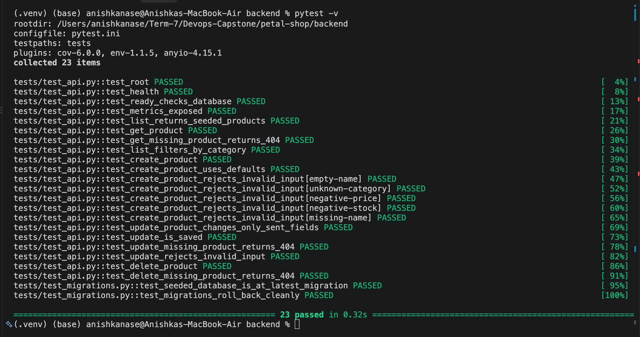
Testing
23 passed
23 tests, all passing.
They run against a separate SQLite test database, never the real one.
Notes:
Before anything is built, the tests run. There are 23 tests covering every endpoint: listing, creating, updating and deleting products, plus bad input. They use a separate SQLite database so they never touch the real data.

Slide 6
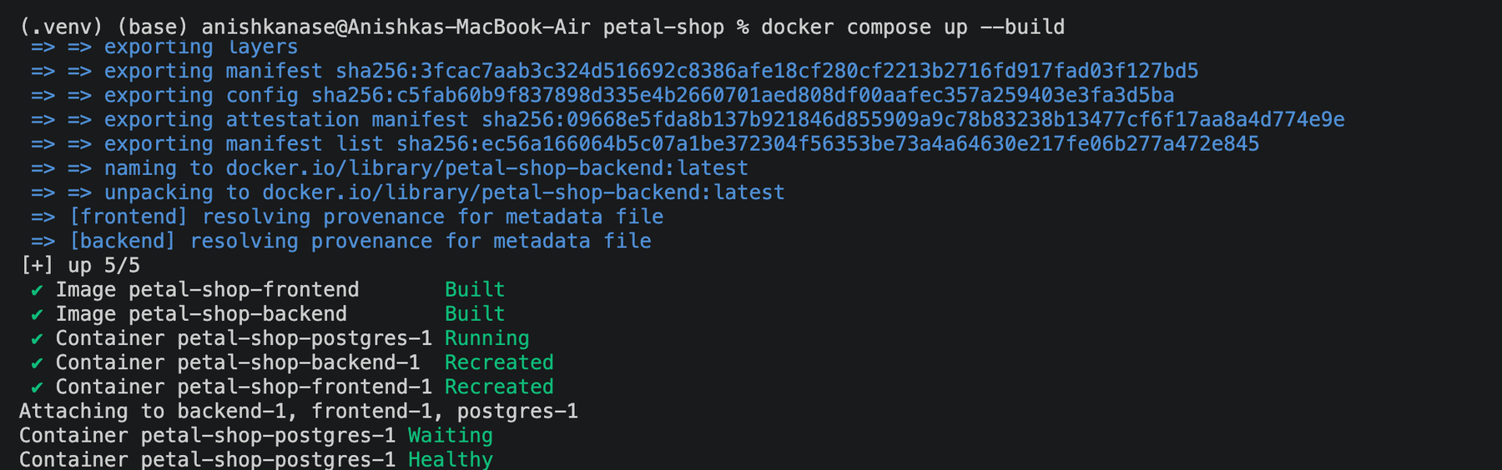
Running with Docker Compose
One command starts the database, backend and frontend together.
Notes:
Before Kubernetes, I ran the whole app with Docker Compose. One command builds the images and starts the three containers. The backend waits until the database is healthy before it starts.

Slide 7
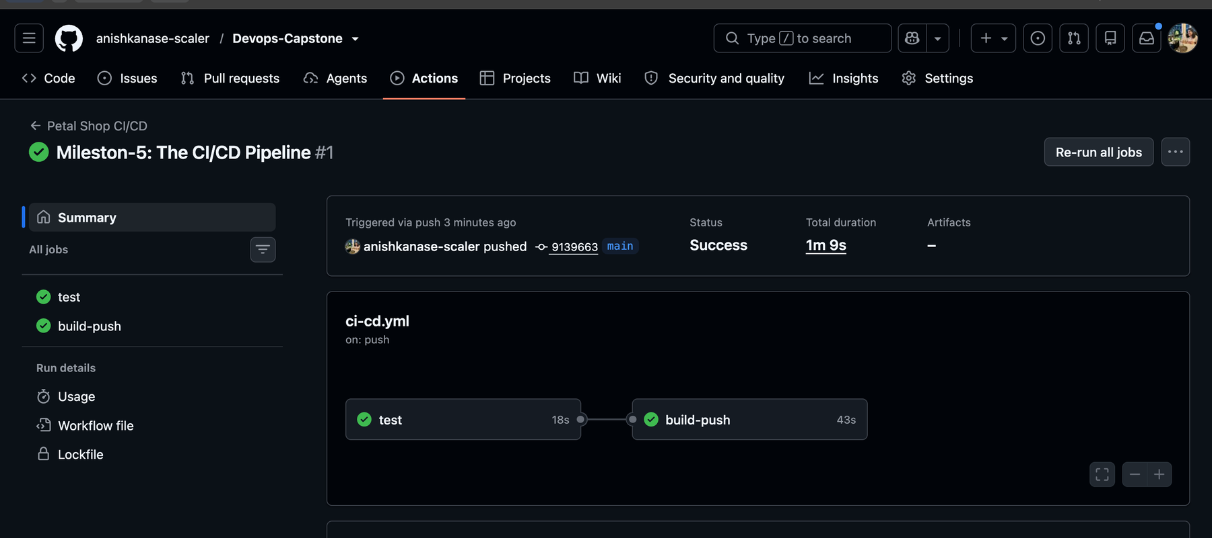
CI/CD pipeline
Every push to main runs two jobs in GitHub Actions: test, then build-push. Both passed.
Notes:
This is my GitHub Actions pipeline. On every push to main it runs the tests and builds the frontend, then builds the Docker images, scans them with Trivy and pushes them to the registry. Both jobs passed.

Slide 8
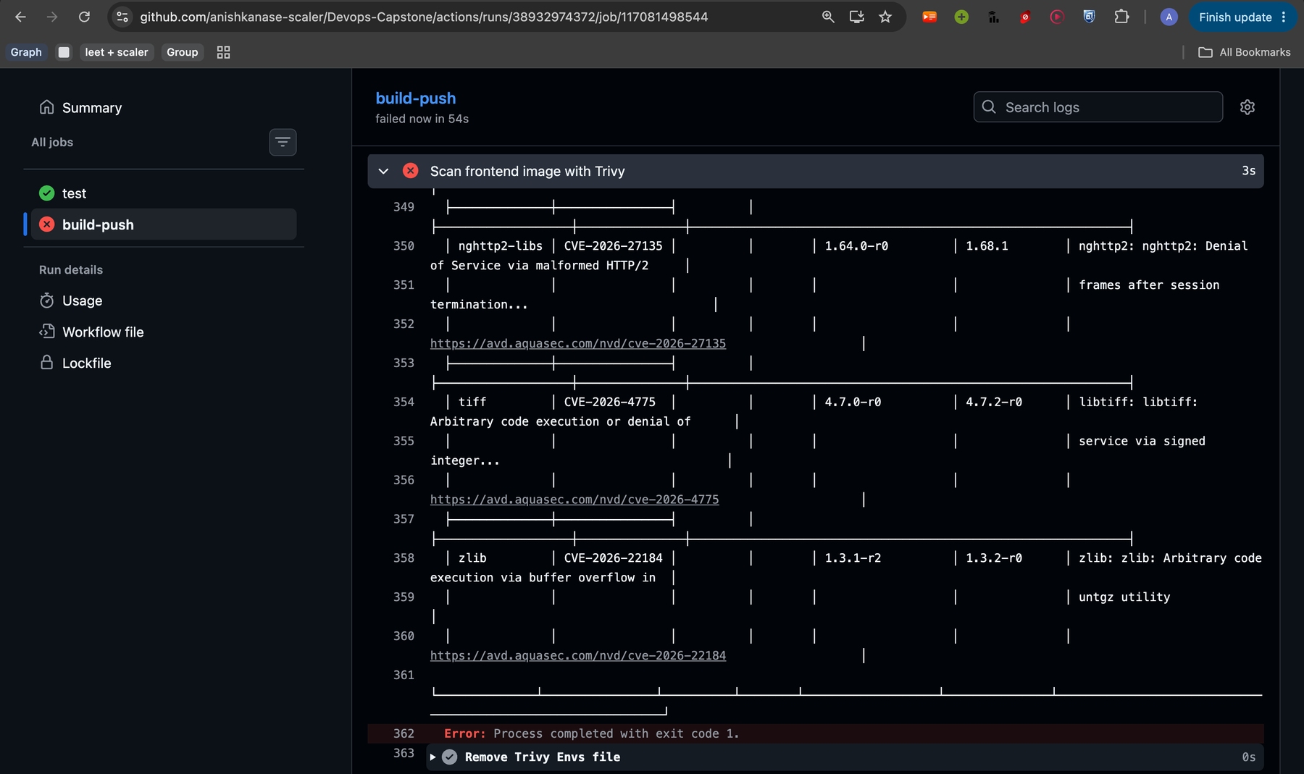
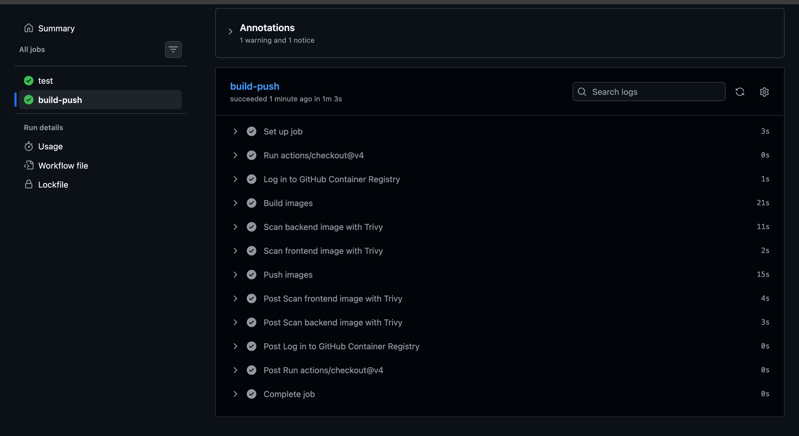
Security scan with Trivy
Before: scan failed, pipeline stopped
After: both scans pass
I updated the old base images, and both scans now pass.
Notes:
Trivy scans both images for known security problems. The first time, it found 2 critical and 39 high issues in the frontend image, so the pipeline stopped before pushing anything. I moved to newer base images and updated the backend libraries, and now both scans pass.

Slide 9
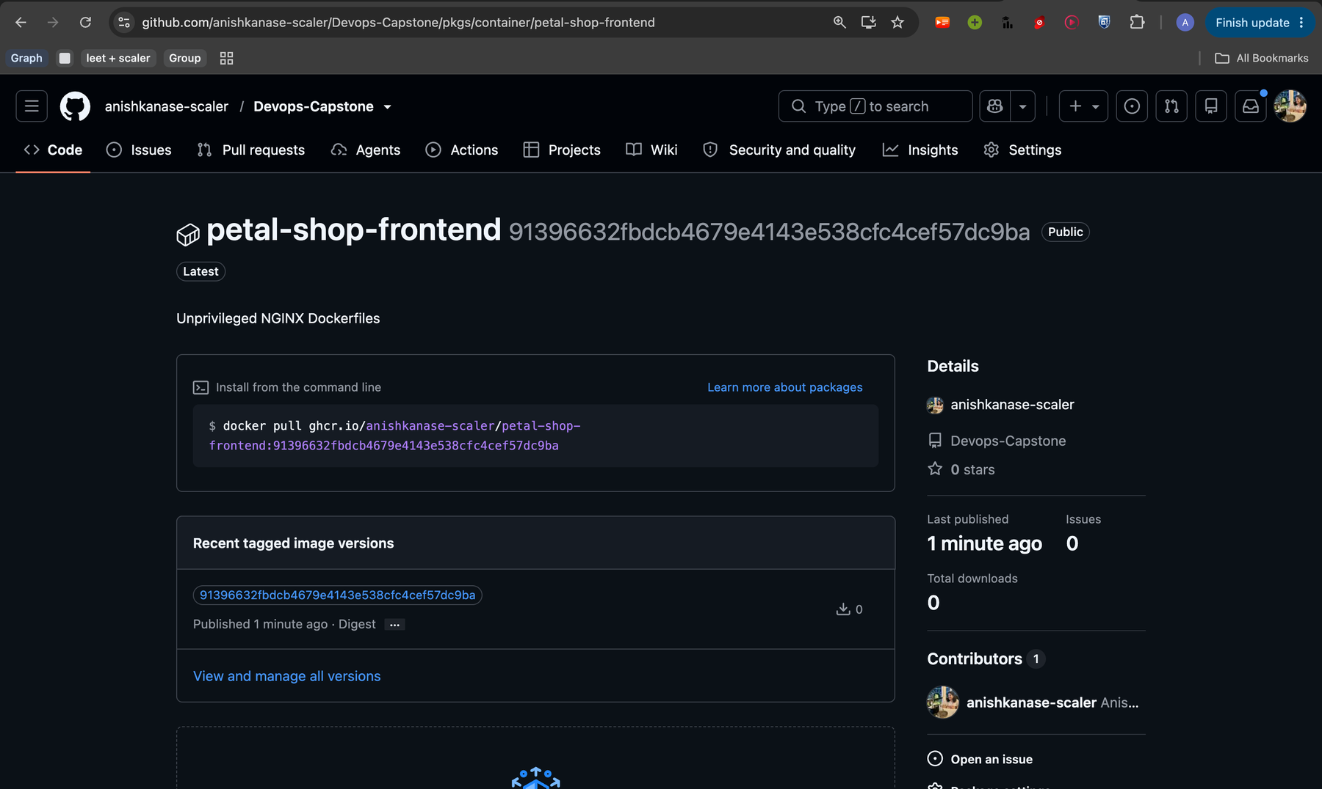
Images in GitHub's registry
Both images are saved in GitHub's container registry (GHCR).
Each image is tagged with the commit ID, not 'latest', so I always know which code it came from.
Notes:
After the scan passes, the pipeline pushes both images to GitHub's container registry. Each image is tagged with the exact commit ID, so every image can be traced back to its code.

Slide 10
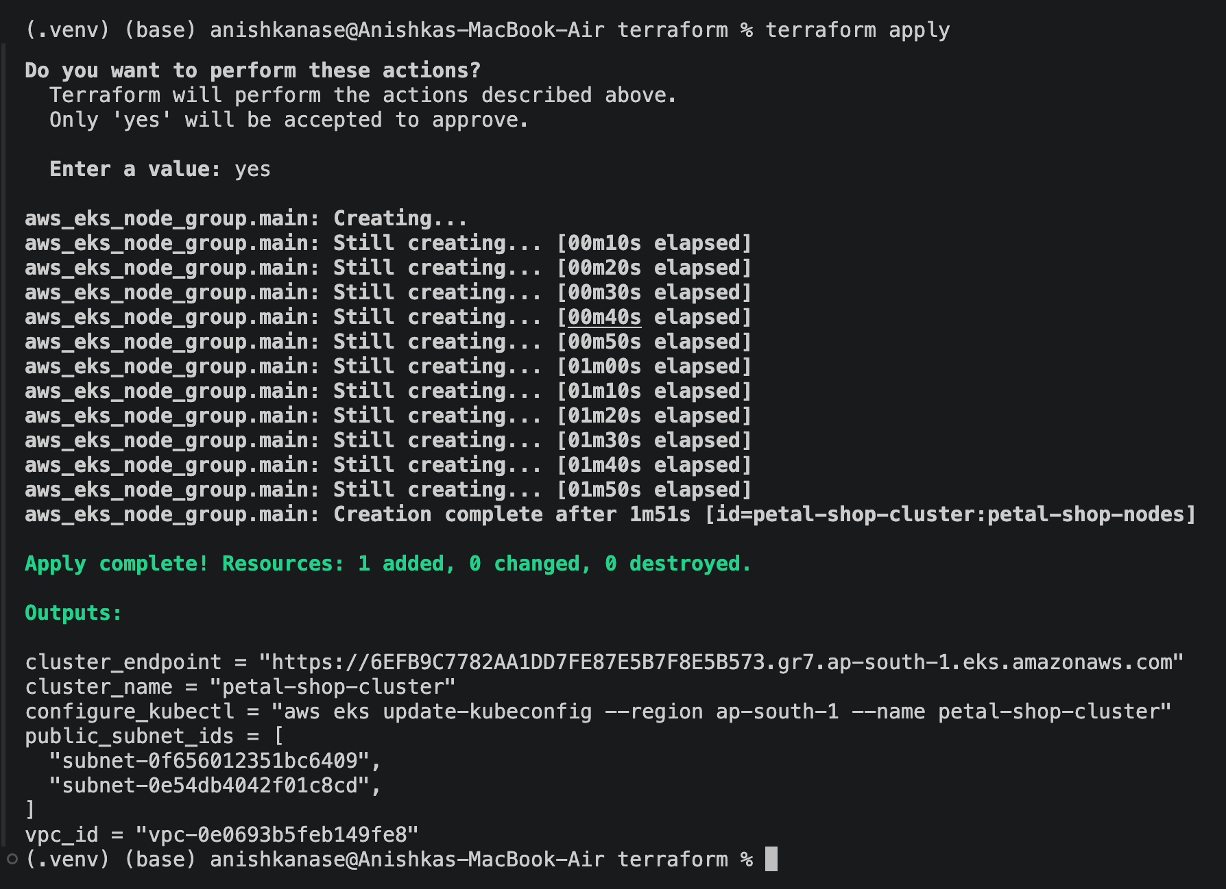
AWS with Terraform
Terraform creates the AWS setup from code.
A VPC, 2 subnets and an EKS cluster in Mumbai (ap-south-1).
Steps: terraform init, plan, apply.
Notes:
Instead of clicking through the AWS console, I described the infrastructure in Terraform files. terraform apply created the network and an EKS Kubernetes cluster called petal-shop-cluster in the Mumbai region.

Slide 11
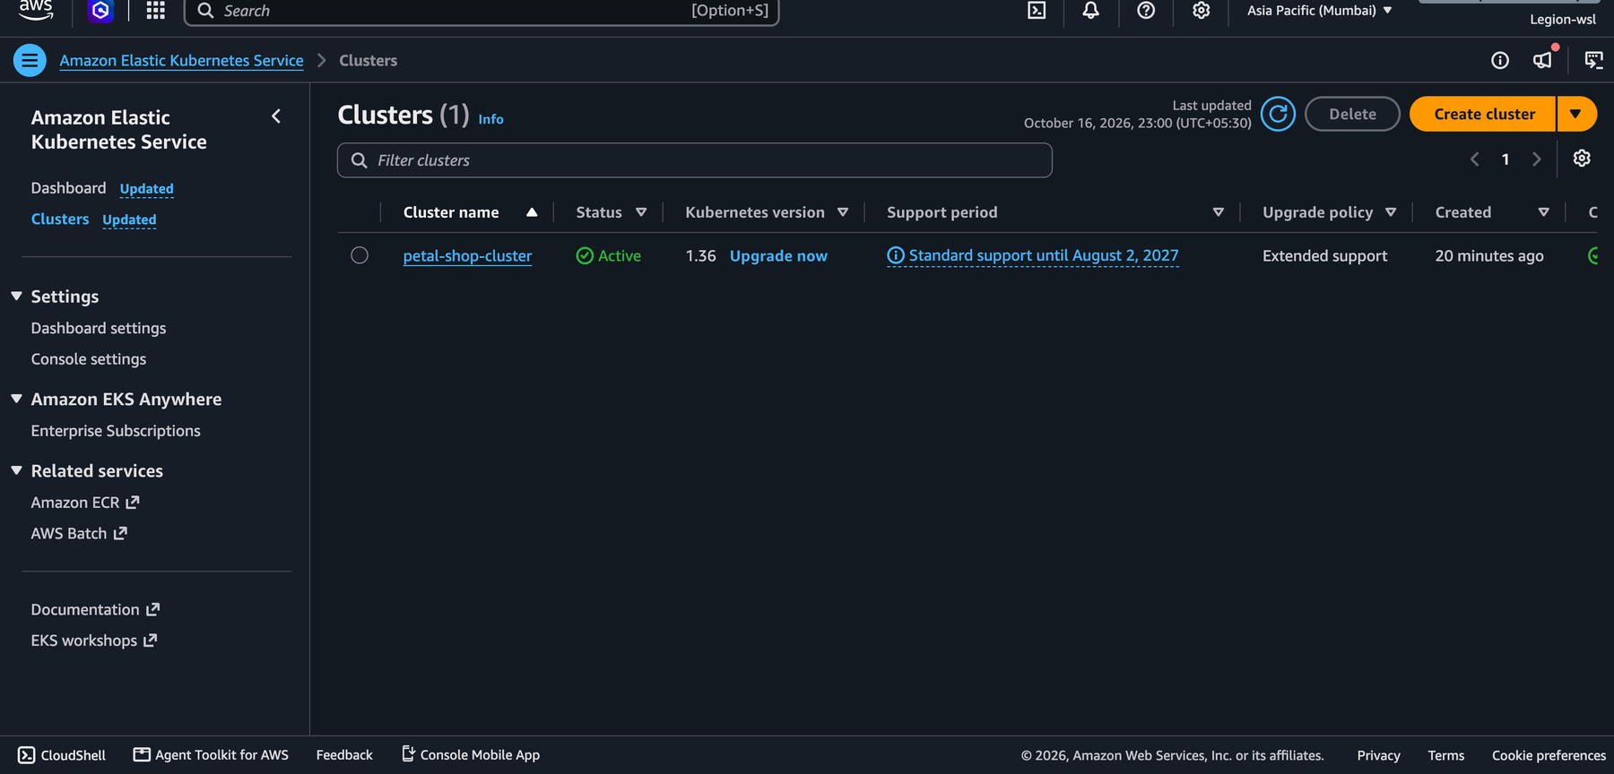
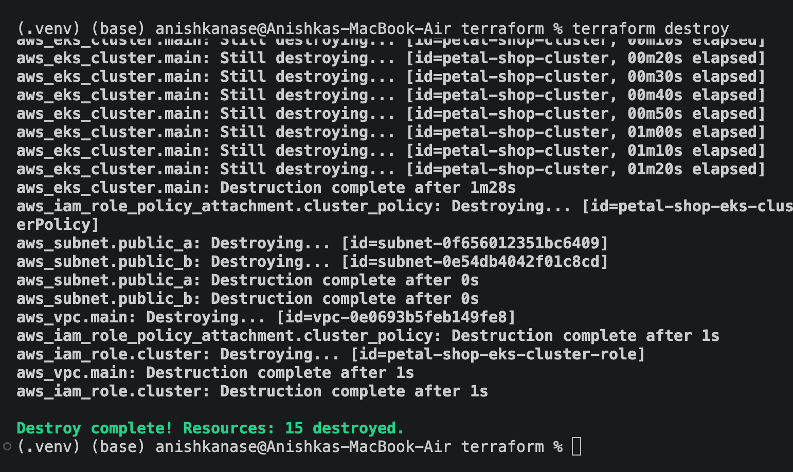
Created on AWS, then removed
The EKS cluster, Active in the AWS console
terraform destroy: 15 resources removed
I checked it in the AWS console, then destroyed it to avoid costs.
Notes:
Here is the cluster running in the AWS console, status Active. After checking it, I ran terraform destroy, which removed all 15 resources so nothing keeps running and costing money.

Slide 12
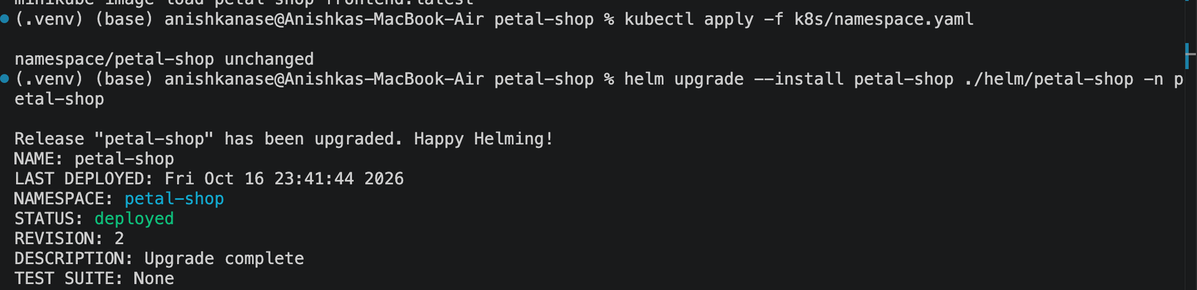
Deploying with Helm
One command installs the whole app on Kubernetes: helm upgrade --install.
Notes:
Helm packages all the Kubernetes files for the app into one chart. One command installs or upgrades the whole app: the database, the backend and the frontend.

Slide 13
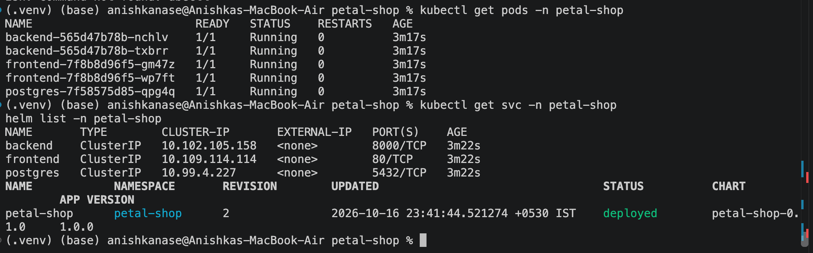
Running on Kubernetes
5 pods running: 2 backend, 2 frontend and 1 database.
Notes:
This is the app on Kubernetes. Five pods are running: two copies of the backend, two of the frontend and one database. If one crashes, Kubernetes starts it again.

Slide 14
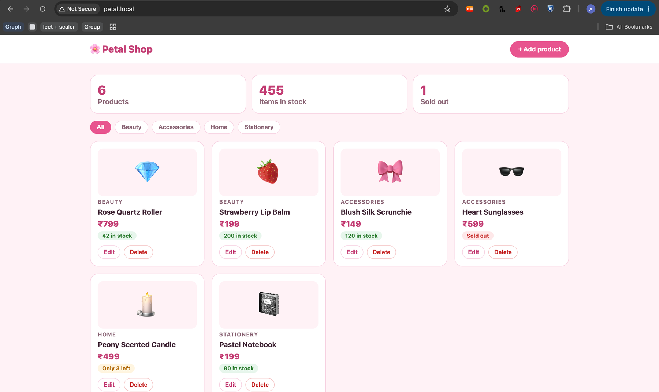
Opening the app
petal.local
The same shop, now served by Kubernetes.
An Ingress sends the page to the frontend and data requests to the backend.
Notes:
This is the same shop opened at petal.local. The Ingress is the entry point of the cluster: it sends the page to the frontend and the API calls to the backend.

Slide 15
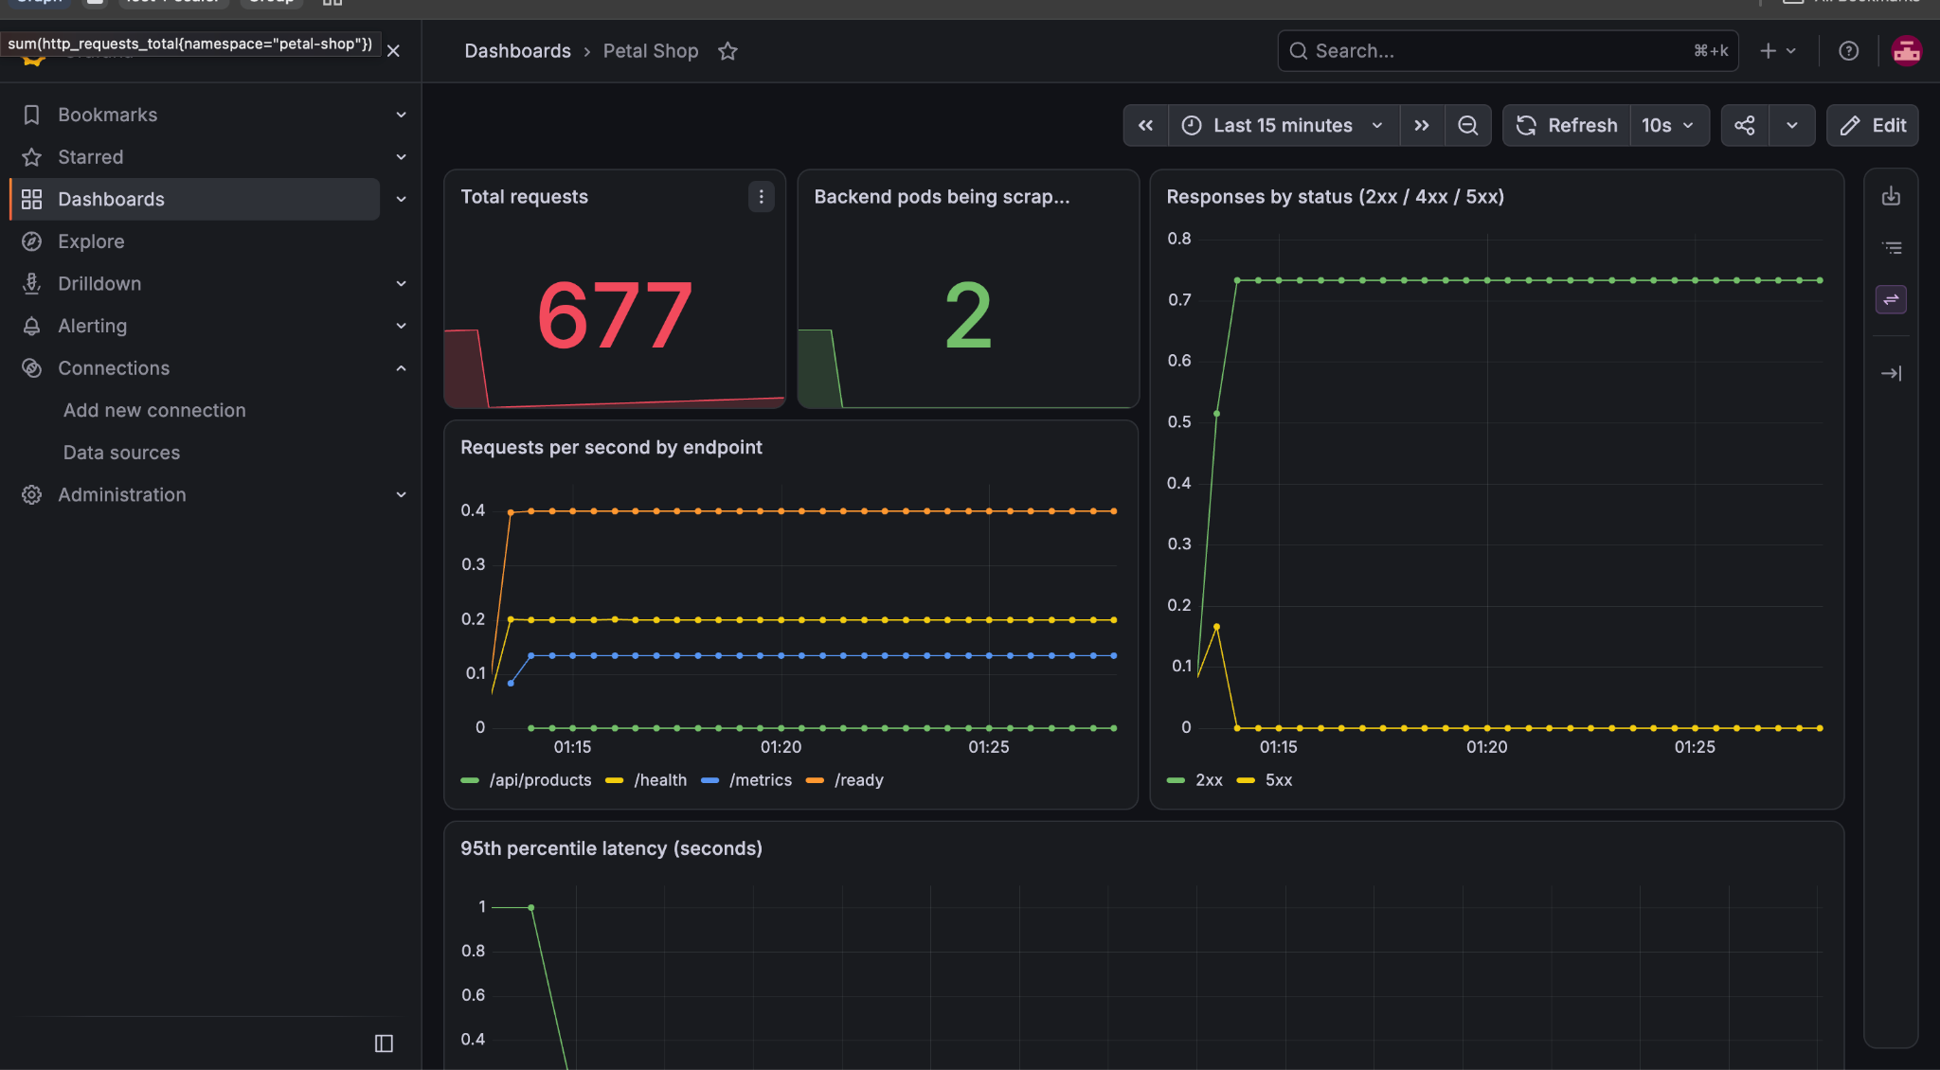
Monitoring
Prometheus collects numbers from the running app. Grafana shows them.
Requests, errors and response time, updated live.
Notes:
Prometheus collects live numbers from the backend every 15 seconds, and Grafana turns them into this dashboard: total requests, requests per second, errors and response time.

Slide 16
Why Kubernetes?
Option | Good | Not so good
Run by hand on a server | Simple to start | Slow, and easy to break
Docker Compose | Great on one machine | Cannot restart itself or scale
Kubernetes (my choice) | Restarts crashed parts, runs 2 copies, safe updates | More to learn
Notes:
There were other ways to run the app. By hand on a server is simple to start but slow and easy to break. Docker Compose is great on one machine but cannot restart itself or scale. I chose Kubernetes because it restarts anything that crashes, runs two copies of each part, and can update the app without downtime. The cost is that there is more to learn.

Slide 17
Thank you
Code: github.com/anishkanase-scaler/Devops-Capstone
Demo video
Notes:
That is Petal Shop: tested, packaged, scanned, published, deployed to Kubernetes and AWS, and monitored. The code and a demo video are linked here. Thank you, I'm happy to take questions.

